Slide 1
X | p | Code(x)
1 | 9/16
2 | 3/16
3 | 3/16
4 | 1/16
0
1
0
1
1
0
1
1
1

Slide 2
X | 1 | 2 | 3 | 4
p | 9/16 | 3/16 | 3/16 | 1/16
Code(x)
0
1
0
4/16
0
1
7/16
1
16/16
0
10
110
111

Slide 3
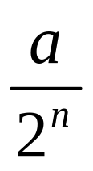
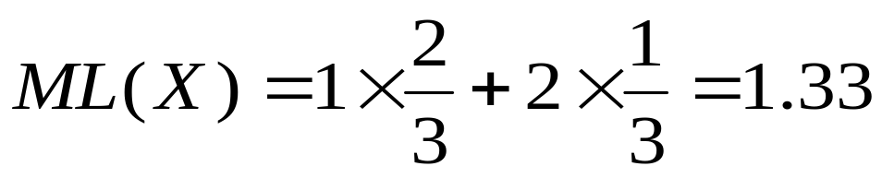
0
1
1/2
2/3
3/4
1
0
Интервалы и код | вероятность
1 [2/3; 1]
Э = 3/4
= 0.11
11
1/3
0 [0; 2/3]
Э = 1/2
= 0. 1
1
2/3

Slide 4
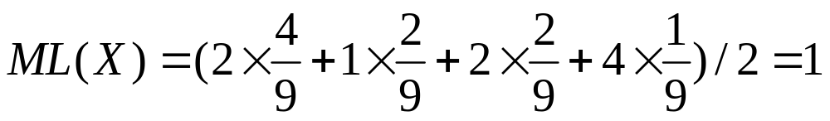
dim(X)=2
0
1
00
01
10
11
1/4
1/2
2/3
3/4
15/16
0
4/9
8/9
1
Интервалы и код |  | вероятность
1[2/3; 1] | 11 [8/9; 1]э 15/16 = 0.1111 | 1/9
 | 10 [2/3; 8/9]э 3/4 = 0.11 | 2/9
0[0; 2/3] | 01 [4/9; 2/3]э 1/2 = 0.1 | 2/9
 | 00 [0; 4/9]э 1/4 = 0.01 | 4/9

Slide 5
dim(X)=3
0
1
00
01
10
11
000
001
1
1/4
1/2
2/3
3/4
15/16
0
8/27
4/9
8/9
Интервалы и код |  |  | вероятность
1[2/3; 1] | 11 [8/9; 1] | 111 [26/27; 1] э 31/32 = 0.11111 | 1/27
 |  | 110 [8/9; 26/27] э 15/16 = 0.1111 | 2/27
 | 10 [2/3; 8/9] | 101 [22/27; 8/9] э 7/8 = 0.111 | 2/27
 |  | 100 [2/3; 22/27] э 3/4 =0.11 | 4/27
0[0; 2/3] | 01 [4/9; 2/3] | 011 [16/27; 2/3] э 5/8 = 0.101 | 2/27
 |  | 010 [4/9; 16/27] э 1/2 = 0.1 | 4/27
 | 00 [0; 4/9] | 001 [8/27; 4/9] э 3/8 = 0.011 | 4/27
 |  | 000 [0;8/27] э 1/4 = 0.01 | 8/27

